Slide 1

BASIC ARABIC -20U1LA1 -INTRODUCTION
By
A.Mohamed Abuthahir,
Asst. Professor in Arabic, Jamal Mohamed College ,Tiruchy-20

Slide 2
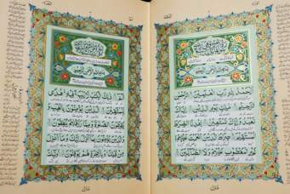
ARABIC IS LANGUAGE OF THE QURAN

Slide 3
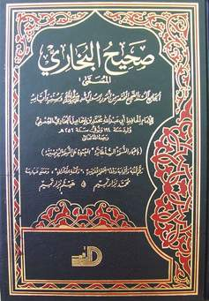
ARABIC IS LANGUAGE OF HADITH

Slide 4
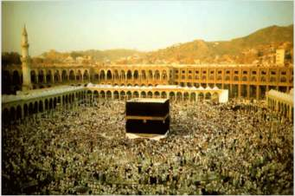
ARABIC IS THE LITURGICAL LANGUAGE OF 2 BILLION MUSLIMS

Slide 5
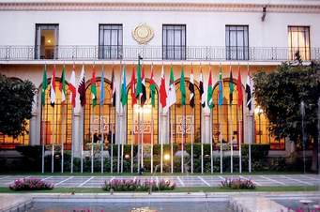
Arabic is official language of 22 countries
Syria,Iraq,Lebanon, Palestine,Jordan, Kuwait,Saudi arabia,Yemen,Oman,UAE,Qatar,Bahrain-Mauritania, Morocco,Algeria,Libya,Tunisia,Egypt,Sudan

Slide 6
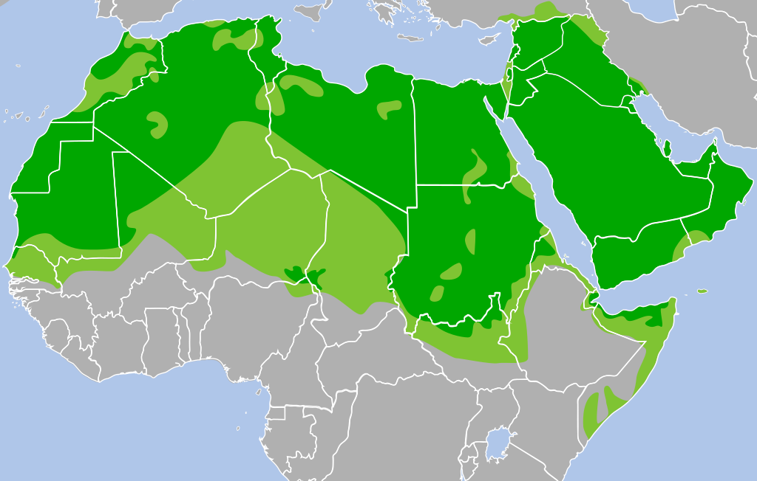
ARABIC GOT A MINORITY & SPECIAL STATUS IN 11 COUNTRIES
CYRPRUS, ERITERIA,IRAN ,MALI,ISRAEL, NIGER, SENEGAL,PAKISTAN ,PHILIPPINES

Slide 7

ARABIC IS ONE OF THE SIX OFFICIAL LANGUAGES OF UNITED NATIONS (UN)

Slide 8
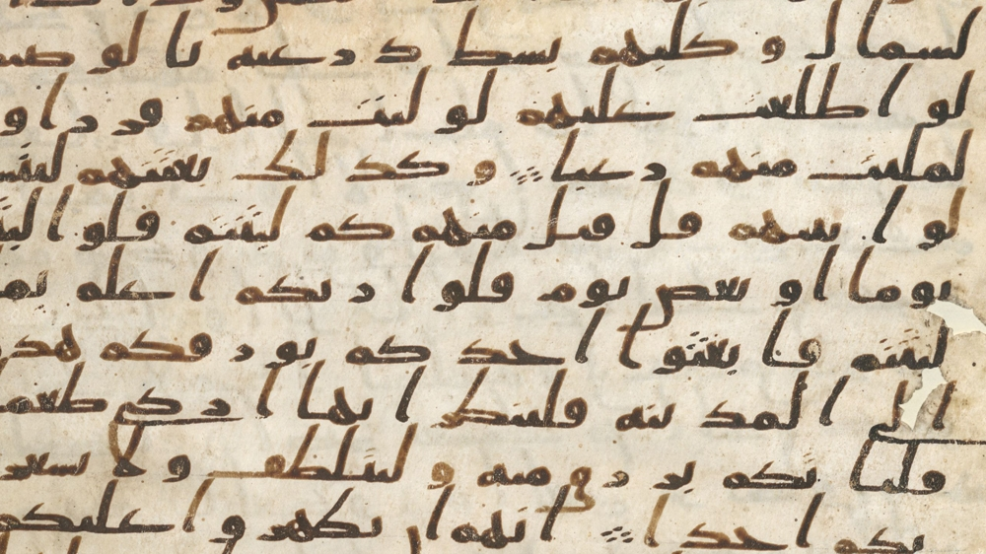
ARABIC IS A CLASSICAL LANGUAGE

Slide 9
Impact of Arabic
ARABIC WORDS IN DAILY LIFE OF TAMIIL MUSLIMS
ARABIC WORDS IN TAMIL | ARABIC | MEANING | ARABIC WORDS IN TAMIL | ARABIC | MEANING
ராஹத்து | راحة | Healthy | கல்ப் | قلب | Heart
முஹப்பத் | محبة | Love | தஅவத் | دعوة | Feast
பரக்கத் | بركة | Blessing | துஆ | دعاء | Supplication
நஸீப் | نصيب | Destiny | கபூல் | قبول | Acceptance
ஹலால் | حلال | Permitted | நிக்காஹ் | نكاح | Marriage
ஹராம் | حرام | Prohibition | வலீமா | وليمة | Reception

Slide 10
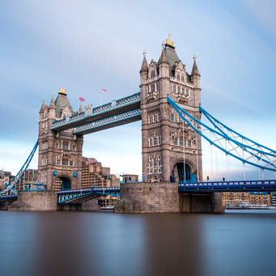
Impact of Arabic
ARABIC WORDS IN ENGLISH
Al gebra Orange
Al cohol Saffron
Al chemy Admiral
Caravan Sofa
Chemistry Syrup
Cipher Soda
Lemon Tamarind

Slide 11
Impact of Arabic
ARABIC WORDS IN URDU
80% urdu words similar to Arabic
ARABIC | Urdu | Meaning | كتاب | كتاب Kitaab | Book
محبة | محبت MUHABBAT | LOVE | كرسي | كرسي KURSI | CHAIR
حقيقة | حقیقت HAQIAT | TRUE | موز | موز MAWZ | BANANA
سؤال | سوال SAWAL | QUESTION | مالك | مالک MALIK | OWNER
جواب | جواب JAWAB | ANSWER | عمل | عمل AMAL | WORK
ضروري | ضروری Zaroori | Essential | كتاب | كتاب Kitaab | Book

Slide 12
Impact of Arabic
ARABIC WORDS IN TAMIL
Arabic word in Tamil | Actual word in tamil | Arabic | Arabic word in Tamil | Actual word in tamil | Arabic
அசல் | மூலம் | أصل | அமுல் | செயல்பாடு | عمل
மாஜி | முந்தைய | ماضي | லாயக் | தகுதி | لائق
அத்து | வரம்பு | حد | ஆஜர் | வருகை | حاضر
முகாம் | தங்குமிடம் | مقام | தகராறு | வம்பு | تكرار
பாக்கி | நிலுவை | باقي | மகசூல் | அறுவடை | محصول

Slide 13
ARABIC LOAN WORDS IN MALAYALAM
Arabic word in Malayalam | Malayalam Romanization | Meaning | Original Form
ഉപ്പ | uppa | father | أب
ഉമ്മ | umma | mother | أم
കത്ത് | kattŭ | letter | خط
താലുക്ക് | tālukkŭ | administrative division | تعلق
പക്കീര്‍ | pakkīr | fakir | فقير
പക്കീര്‍ | pakkīr | fakir | فقير
പത്തിരി | pattiri | Pathiri | فطيرة
രൊക്കം | rokkaṁ | ready cash | رقم
റദ്ദ് | ṟaddŭ | cancel, deactivate | رد
വക്കാലത്ത് | vakkālattŭ | power of attorney | وكالة

Slide 14
Impact of Arabic
HINDI WORDS FROM ARABIC
Roughly 25% of Arabic loanwords are in spoken Hindi
SOME ARABIC WORDS IN HINDI WITH ENGLSIH MEANING
Qalam‘ (क़लम قلم) -pen | 'Khabar' (ख़बर خبر)-news,
'Kitāb' (किताब کتاب)-book, | 'Ajīb' (अजीब عجیب)-unusual,
'Qarīb' (क़रीब قریب) -near, ' | 'Qānūn' (क़ानून قانون)-law,
'Gharīb' (ग़रीब غریب)-poor, 'Waqt' (वक़्त وقت)-time | 'Sharbat' (शर्बत شربت)-drink/beverage Duniyā (दुनिया دنیا)-world

Slide 15
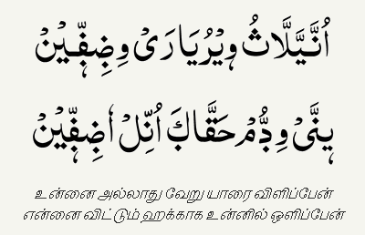
Impact of Arabic
ARWI LANGUAGE
(TAMIL IN ARABIC SCRIPT MIXED WITH FEW ARABIC WORDS)

Slide 16
Impact of Arabic
ARABIC SCRIPT FOR VARIOUS LANGUAGES
`
 | language | Arabic Script | Country |  | language | Arabic Script | Country
 | Kyrgyz | قىرعىز | Kyrgyzstan |  | Balochi | بلۏچی | Afganisthan
 | Kurdish | کوردی‎ | Iraq & Turkey |  | Urdu | اُردُو | India & Pakisthan
 | Uzbek | اۉزبېک | Uzbekisthan |  | Pashto | پښتو | Afganisthan
 | Persian | فارسی | Iran |  | Uyghur | ئۇيغۇر | Xinjiang(China)
 | Turkmen | تۆرکمن | Turkmenistan |  | Sindhi | سنڌي | Sindh (Pakisthan)

Slide 17

Impact of Arabic
ALIF LAILA – 1001 NIGHTS

Slide 18

Impact of Arabic
LAILA MAJNUN (EPIC)

Slide 19
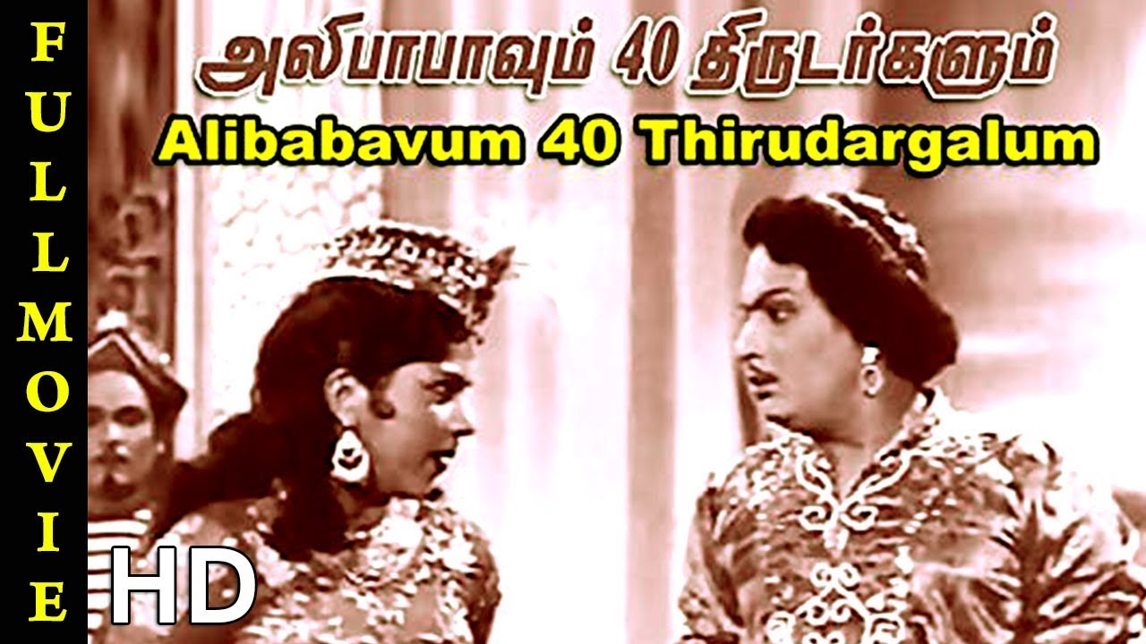
Impact of Arabic
ALI BABA & 40 THIVES
علي بابا والأربعون لصا

Slide 20
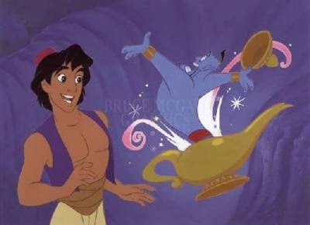
Impact of Arabic
ALAVUDEEN & MAGIC LAMP
அலாவுதீனும் அற்புத விளக்கும்

Slide 21
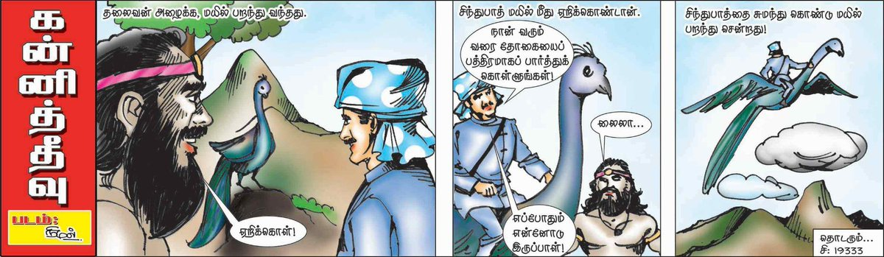
Impact of Arabic
கன்னித் தீவு
SINDHUBAD

Slide 22
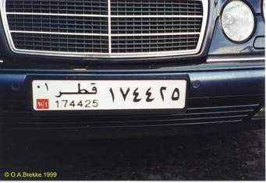
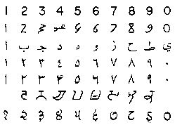
IMPACT OF ARABIC
ARABIC NUMERALS

Slide 23

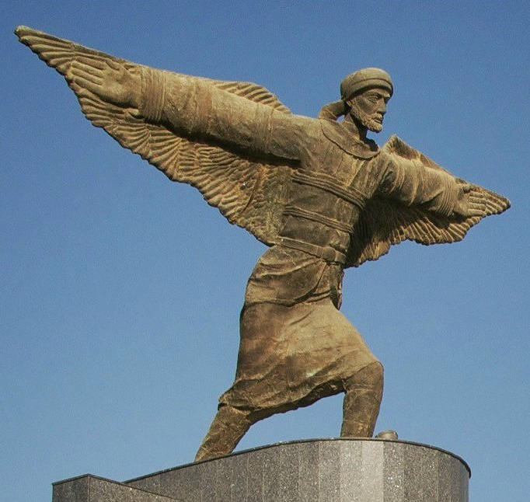
Arabs contribution
IBNU FIRNAS
PIONEER OF AVIATION
FLIGHT
ENRANCE OF BAGHDAD AIRPORT (STATUE OF IBNU FIRNAS

Slide 24

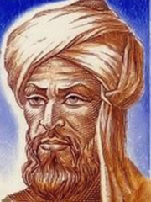
ALGORITHM & AL JIBRA
MUSA ALGHAWARIZMI

Slide 25
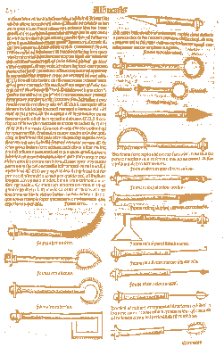
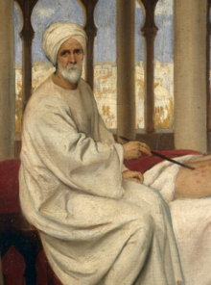
ARABS CONTRIBUTION
AL-ZAHRAWI – SURGEON
Medical Encyclopedia & surgical equipments
Surgical Equipments
Al Zahrawi

Slide 26
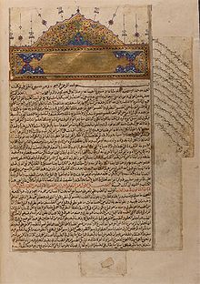
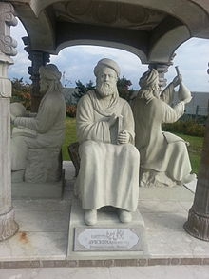
ARABS CONTRIBUTION
AVICENNA (IBNU SINA)
AL QANUN FI’T TIB- CANON OF MEDICINE
SCRIPT
AVICENNA

Slide 27
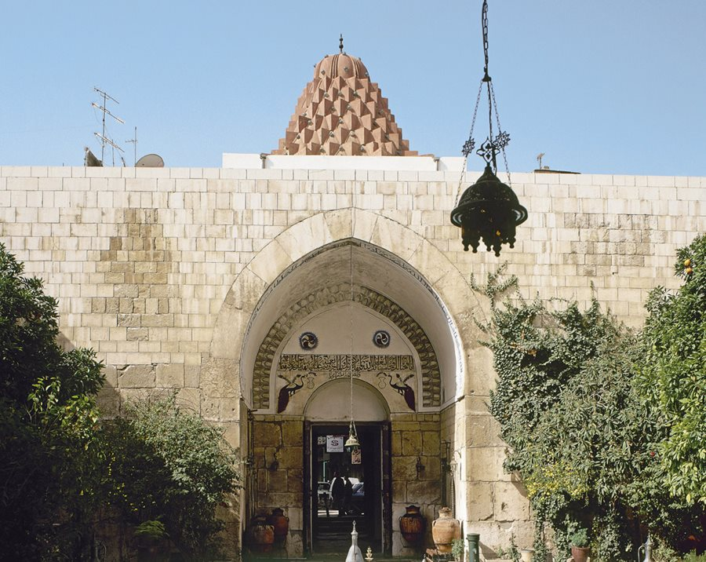
ARABS FOUNDED FIRST HOSPITAL (BIMARISTHAN IN DAMASCUS ,SYRIA)
Umayyad caliph al-Walid I, 705 to 715

Slide 28

Arabs contribution
University of al-Qarawiyyin (Est on 850 AD)
Founded by Fathima Al Fihri,At Morocco, world old university cited by UNESCO & Guiness

Slide 29
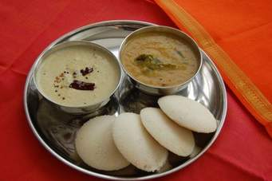
ARABS CONTRIBUTION
ARABS INTRODUCED IDLI IN TAMILNADU

Slide 30

ARABS CONTRIBUTION
COFFEE DISCOVERED BY ARABS (IN YEMEN)

Slide 31


ARABS CONTRIBUTION
ARAB INVENTION – TOOTH BRUSH

Slide 32
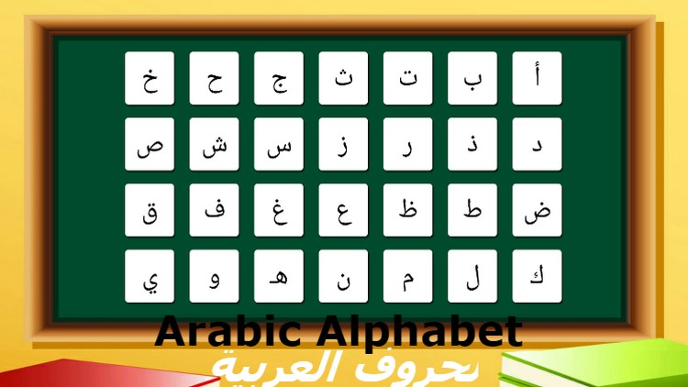
ARABIC HAS 28 ALPHABETS

Slide 33
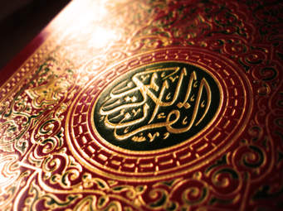
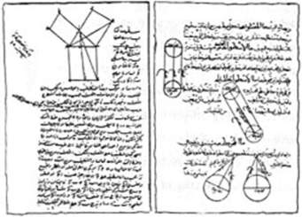
Types of Arabic
CLASSICAL ARABIC
QURAN
ARABS MANUSCRIPT

Slide 34

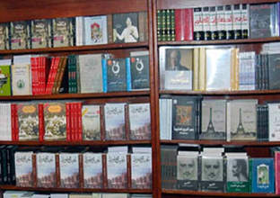
Types of Arabic
MODERN STANDARD ARABIC
NEWS
BOOKS

Slide 35

Types of Arabic
Colloquial Arabic
Above 30 dialects widely in use
Yemen,
Sudanese,
Egyptian,
Levantine (Iraq & Syria)
Peninsular Arabic ( Saudi Arabid, UAE, Qatar,Kuwait, Bahrain)
Moroccan
Palastine

